Slide 1
Realtime Rendering for Artists
…or Mike’s best stab at it.
The year is 2012.
This information will probably become outdated.

Slide 2
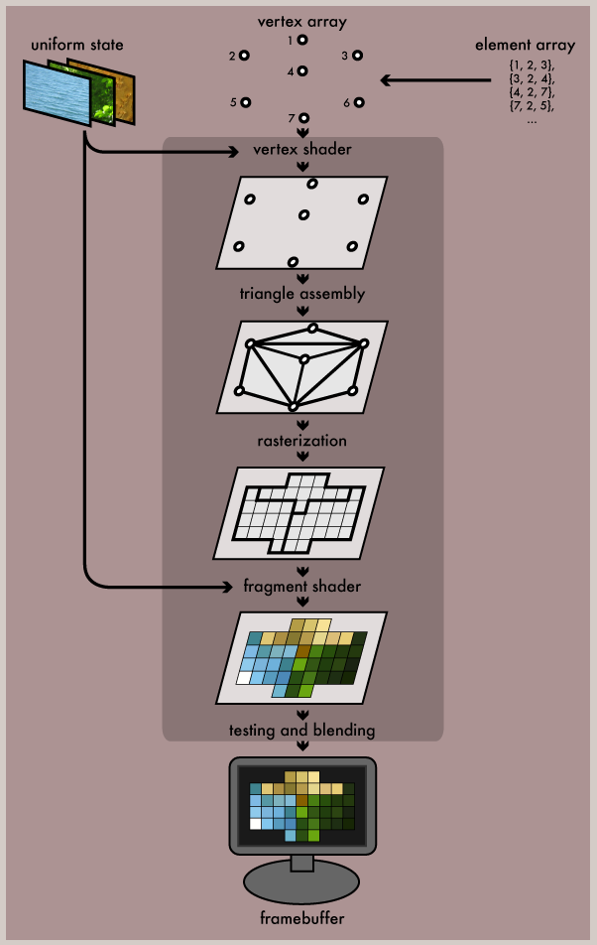

Slide 3
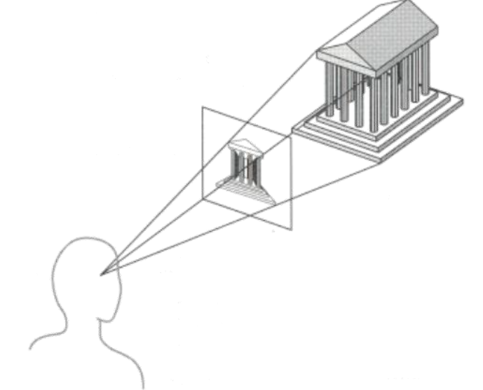
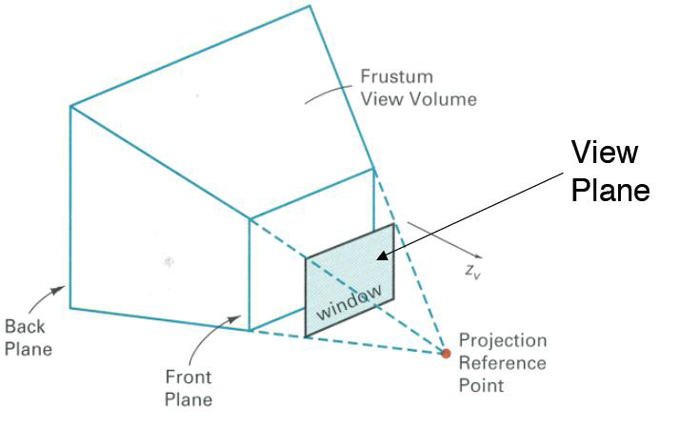
World-space and Screen-Space
Purpose of rendering is to convert data in world-space to an image in screen-space.
I’m going to be skipping telling you much about the transformations required, since its not something which really affects art assets.

Slide 4
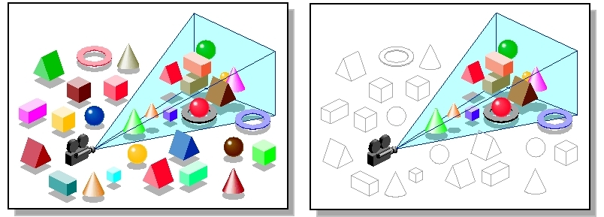
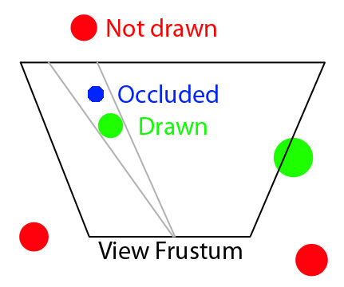
Culling
Objects outside of the view frustum cannot be seen so we don’t want to waste time rendering them. We call this “culling”.
Cheap check: does no part of the bounding box/sphere cross into the frustum?
Expensive check: is the object entirely occluded by another object?

Slide 5
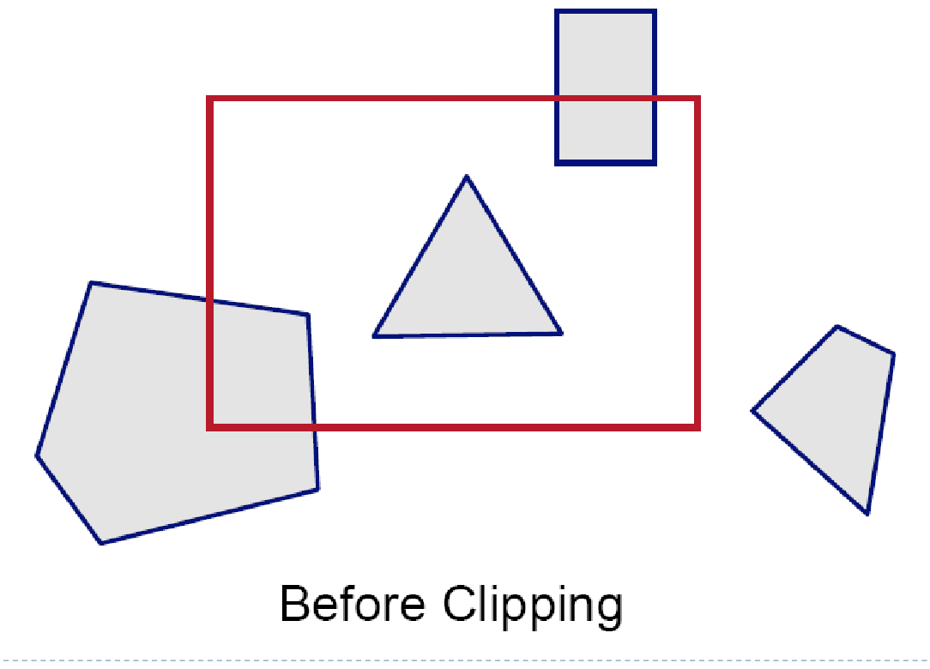
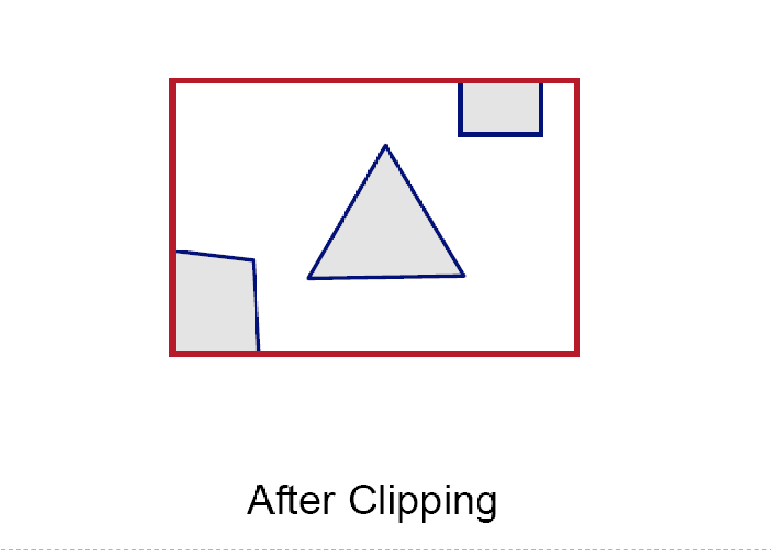
Triangle culling
Triangles outside of the view plane? Cull them.
Triangles facing away from camera? Cull them.
Triangles partly outside of the view plane? Split the geometry and cull the new geometry which is outside the screen.

Slide 6
…and then it colours them in…?
…and every engine does it differently…

Slide 8
Let’s look at our data more closely…
Notes:
Definitions vary

Slide 9
Model
Typically, a model contains:
One or more meshes
X, Y, Z position
X, Y, Z rotation
X, Y, Z scale (if allowed by engine)
(animation only) bones

Slide 10
Mesh
Typically, a mesh contains:
Many Vertices
One shader
Information about this mesh (varies with engine)
What LOD level am I
Am I collision
Etc
Notes:
So as far as the graphics card is concerned, multi-sub object materials are multiple meshes.

Slide 11
Vertices
Typically, a vertex contains:
X, Y, Z co-ordinates relative to the model’s origin
U, V co-ordinates for mapping to a texture (one set of UVs per channel)
One vertex normal – the direction the vertex is pointing
(optional) Colour – used as information for the shader
(animation only) Weight – weighting to one or more bones

Slide 12
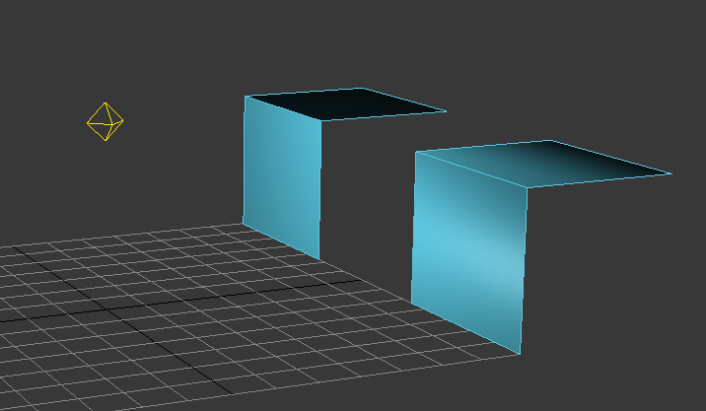
Vertex Normals?
Artists typically control vertex normals (often unwittingly!), by using Smoothing Groups (3ds Max) or hard/soft edges (Maya)

Slide 13
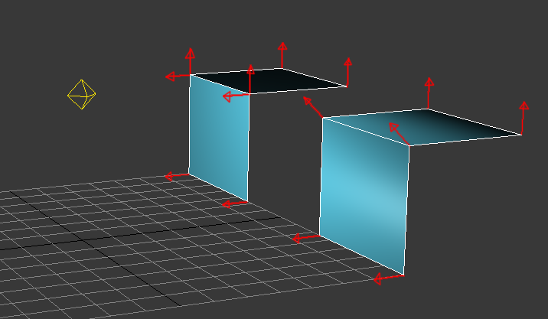
Vertex Normals?
Vertex normals say which way the vertex is pointing, as far as shading is concerned.
The object on the left has 8 vertices
The object on the right has 6 vertices

Slide 14
But how does it colour them in…?

Slide 15
Render Passes
A bit of a loose, undefined term, but I’m going to go with:
The renderer has to complete a series of “objectives” one after another in sequence. We call these objectives render passes.
Example of render passes in sequence:
Draw all geometry with opaque materials
Once complete, draw all geometry with translucent materials
Once complete, add bloom in post-processing

Slide 16
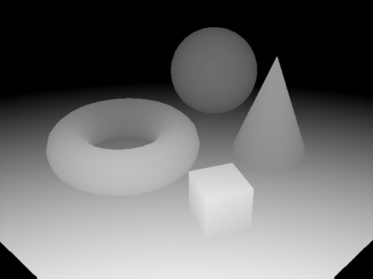
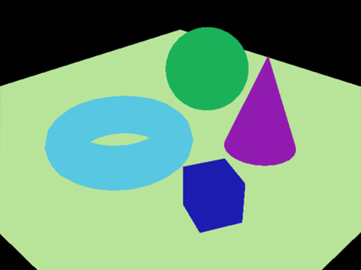
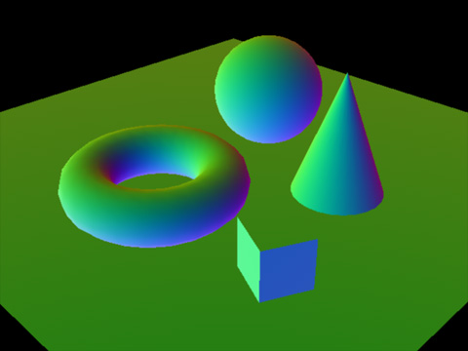
Buffers
As each render pass completes, it records information to buffers. Typical buffers include:
Frame buffer – records the “final” output of coloured pixels to send to the display
Vertex buffer – records information about all relevant vertices
Z Buffer – records the “depth” of pixels relative to the viewer
G Buffers – record per-screen-pixel information such as diffuse colour and normal direction (deferred rendering only)
You can think of buffers as “fast memory for GPUs”

Slide 17
Draw calls
A draw call is rendering one “mouthful” of data. A draw call contains exactly one mesh and no more. A draw call typically contains exactly one light (and possibly an ambient light level).
Draw calls have a lot of overhead so “few big mouthfuls” will result in better performance than “many small mouthfuls”.
Therefore, using fewer, larger meshes can be cheaper than many, smaller meshes. Other factors weigh in here too, so be sensible.
We can also conclude that we can reduce draw calls by reducing the number of dynamic lights which affect a mesh (forward rendering).

Slide 18
Is it always done the same way…?

Slide 19
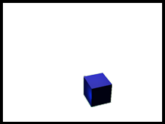
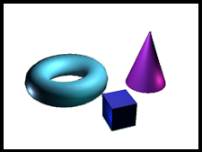
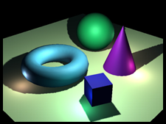
Forward shading ex. Unreal Engine 3 DX9
Forward Shading:
Shading (including lighting) is performed from the first pass.
Multiple draw calls are required when more than one light hits a mesh (not illustrated below).
Many lights will cause a big performance hit.
Does not need a large buffer size (GPU fast-memory)
Notes:
In forward shading we take each pixel and seek to find its final outcome there-and-then. This means we calculate shading (lighting) on our very first draw call. However, since a draw call contains only one light, forward-rendering is very inefficient with many dynamic lights, repeating many of the same steps in each draw call for each light.
In deferred shading, we record all the “ingredients” we need (diffuse colour, specular colour, normal direction, etc) in our first pass, but don’t add any lights. In our second pass we take our ingredients and feed them in per light. By short-handing all the ingredients we need, there is no wasted time, so we can handle very many lights.

Slide 20
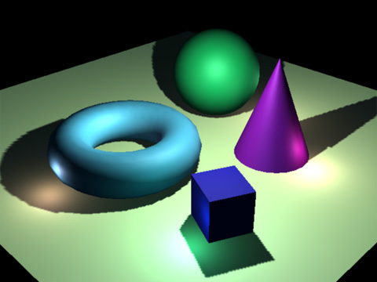
Deferred shading ex. CryEngine 3
Deferred Shading
In the first pass, gather the information necessary for shading (diffuse, specular, normal) and record to a screen buffer.
In the second pass calculate the lighting using information from the first pass
Regardless of the number of lights, geometry only needs to be read in once.
Many lights will not cause a big performance hit.
Needs a large buffer size such as PC hardware
Notes:
In forward shading we take each pixel and seek to find its final outcome there-and-then. This means we calculate shading (lighting) on our very first draw call. However, since a draw call contains only one light, forward-rendering is very inefficient with many dynamic lights, repeating many of the same steps in each draw call for each light.
In deferred shading, we record all the “ingredients” we need (diffuse colour, specular colour, normal direction, etc) in our first pass, but don’t add any lights. In our second pass we take our ingredients and feed them in per light. By short-handing all the ingredients we need, there is no wasted time, so we can handle very many lights.

Slide 21
What about lighting and shadows…?

Slide 22
Realtime Lighting ex. CryEngine 3 (and most engines to a lesser extent)
Realtime lighting is only achievable when sacrifices are made. Common sacrifices include:
Direct light only – no bounces or global illumination
Point lights only – light emits from a single point in space, resulting in very sharp shadows
Binary shadows – lit or unlit, therefore cannot reduce to, say, 60% as it passes through translucent materials like glass
Monochromatic light – light from one source cannot separate into different colours or be tinted by passing through stained glass etc
No scattering of light as it passes through different materials/atmospheres (smoke, water, air, glass)
Few lights – since each light adds to the cost, as few lights are used as possible.
More powerful hardware is allowing newer renderers to give realtime approximations for many of the above, but accuracy is still sacrificed.

Slide 23
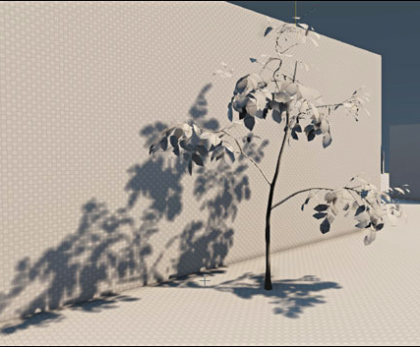
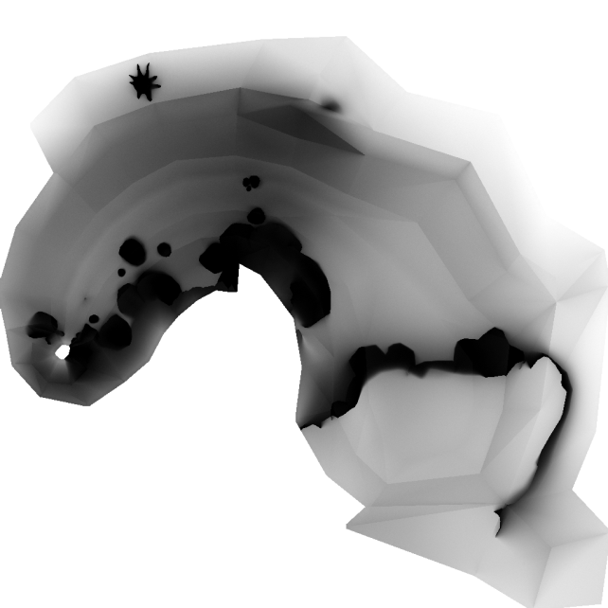
Baked Lighting (Lightmaps) ex. Unreal Engine 3
Lightmaps allow the use of extremely expensive lighting algorithms, and recording them to textures to be applied at runtime.
Here, the sacrifices are:
Static – cannot be recalculated in realtime, so except for dynamic shadows, the light is completely fixed (pretty much).
Memory use - texture memory to store lightmaps
Unique UVs - Artist must create a second set of UVs so that all faces have unique texture space

Slide 24
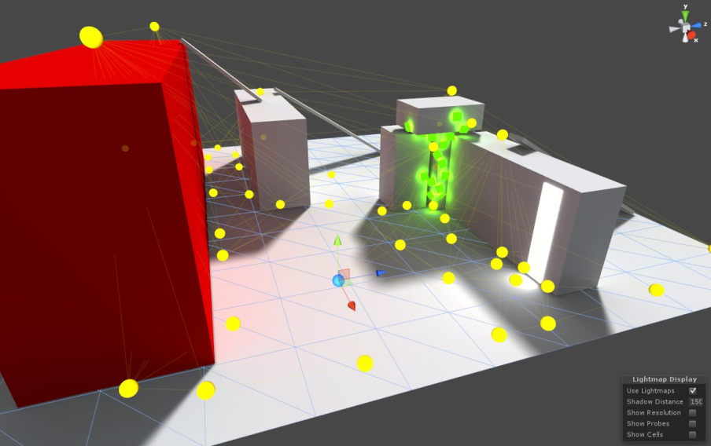
Light Probes for dynamic objects in lightmapped scenes
Dynamic objects cannot meaningfully be lightmapped.
If we have used hundreds of lights, this is not practical for realtime
Instead we record the amount and direction of lights received by strategic points throughout the scene.
Dynamic objects use the nearest probe (or an interpolation) to decide where light should come from and its strength.

Slide 25
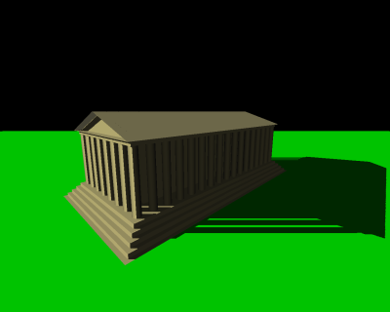
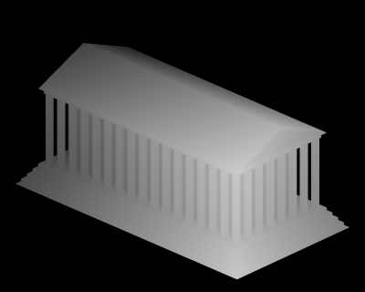
Shadow Mapping
A shadow map is a texture map from a light’s point-of-view recording the distance between the light and the nearest surface.
If either the light moves or objects in the scene move, this must be recalculated (expensive)
Large radiuses increase the chance the shadow map has to be recalculated
Most engines using shadow maps expect to have to create no more than two or three new shadow maps per frame.
High resolution shadow maps take longer to calculate.
A light is positioned above and at 45 degrees to this temple
The distance to the temple from the light’s point-of-view

Slide 26
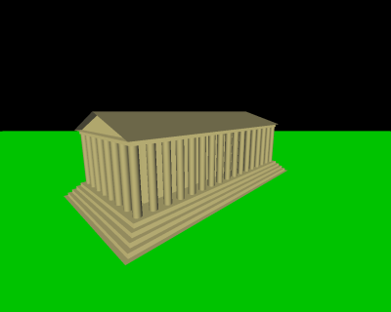
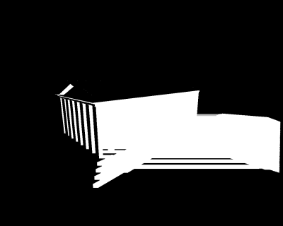
Shadow Mapping
For every pixel in the player’s view, we check the Z-depth and find its position in world space.
If its within the light’s radius, we convert that position into the light’s viewspace.
If the position is further than the distance in the shadow map, it is behind the closest object to the light, so it receives no light.
If its position is closer, we light it, and the thing behind receives no light.
Player view fully lit
Light View (distance to nearest)
Player View showing pixels which were found to be behind nearest

Slide 27
So how does this affect the art assets I make and how I make them…? OPTIMISATION!

Slide 28
OPTIMISATION – only use lights and shadows that you need to

Slide 29
Lighting optimisations
Forward renderer with lightmapping:
Bake as much lighting as you can
Use as few dynamic lights as you can
Avoid overlapping dynamic lights as much as possible
Deferred shading renderer with realtime-only lighting:
Avoid excessive light overlapping
Avoid many large light radiuses
Any renderer
Cast shadows from as few lights as possible
For small lights, use low shadow map resolutions

Slide 30
OPTIMISATION – plan geometry and “splits”

Slide 31
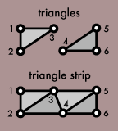
Shading strips
Shaders require vertex information (normal, colour) for each pixel on the screen. This must be interpolated.
We can do this faster if we “roll over” from one triangle to another by adding only one vertex. Triangles in a sequence like this are called strips.
Long strips mean we can shade a lot of triangles more quickly.

Slide 32
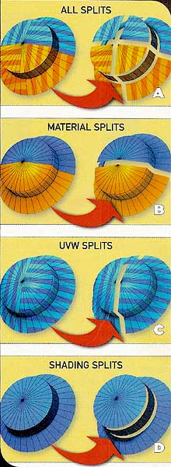
Breaking strips
Several factors cause breaks in strips. This causes shorter strips and more vertices, resulting in slower shading and more memory usage.
Material splits will split the model into two meshes = an extra draw call (!)
UVW splits = additional vertices, slower render. True for each UV channel.
Shading (smoothing) splits = additional vertices, slower render.

Slide 33
Familiar?
The object on the left has 2 strips
The object on the right has 1 strip

Slide 34
Aligning Splits
However, splits only happen once, so having a hard edge/changing smoothing group along a UVW seam is no additional cost since it is already split.
The same logic applies to UVW channels – if you have a second UVW channel for your lightmap, try to split it in the same places as your channel 1 UVW splits.

Slide 35
OPTIMISATION – implement levels of detail (LODs)

Slide 36
Levels of Detail (LODs)
In a scene full of trees, let’s assume each tree is 1000 triangles.
Below we can see that about 20% of the screen is filled by the closest tree, at 1000 triangles.
The distant 4 trees fill up less than 5% of the screen space, and yet are a total of 4000 triangles.
This is expensive and unnecessary. Most triangles will be smaller than 1 pixel of screen space!
Scene from above with viewing frustum
Screen-space view

Slide 37
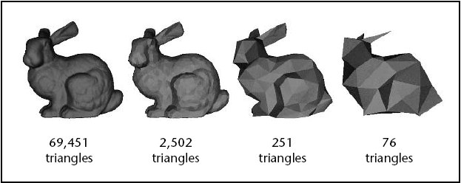
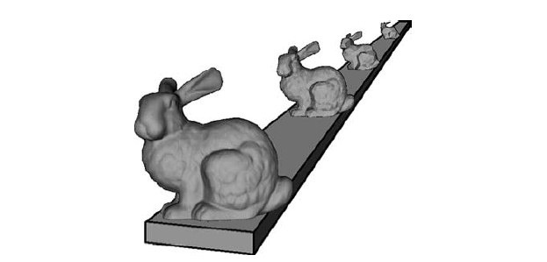
Levels of Detail (LODs)
LOD 2
To avoid this unnecessary render cost, we typically author more than one version of our model. These are cheaper (fewer triangles, cheaper shader etc)
Although this has a memory cost it reduced the number of triangles sent through the rendering pipeline greatly, with minimal loss of quality.
LOD 1

Slide 38
OPTIMISATION – the “right” size of mesh

Slide 39
Mesh Size Example: a large building
One large mesh
Fewer draw calls
Cannot be culled if any part of it is seen, so we very often have to push the whole lot through
Therefore good for objects in the distance (likely to need the whole thing)
Many small meshes
More draw calls
Easier to cull
Identical pieces can use instancing.
Identical features (ex. Tree, crate etc)
Tileset used to construct larger structures (pillars, arches, walls, windows)

Slide 40
Tileset Instancing
Artist can introduce variety in the scene by rearranging components easily
Memory usage is reduced because of less unique geometry
Optimisations allow rendering time to be reduced when several instances need to be rendered in one pass
Smaller pieces are much better for being culled
However
Lots of small meshes = lots of draw calls
Current-gen (‘12) console GPUs not well-optimised for instancing

Slide 41
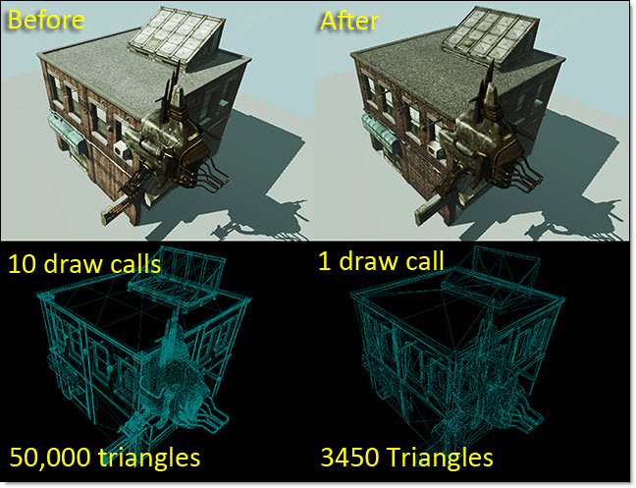
Geometry and Texture Combining
Each mesh = one draw call.
Combining meshes and textures will reduce draw calls (so long as they can share the same shader).
However:
combining meshes reduces “positionability”.
Combining textures is of limited benefit if they still use multiple draw calls
Combining textures is wasteful if objects on the texture are not in use in your scene.
UDK features Simplygon Merge Tool for combining static meshes to reduce draw calls and cull fully hidden faces

Slide 42
Instance or combine?
Combine:
When you have spare memory, combine to reduce draw calls and reduce render time
When the combined mesh will typically not fill the screen (ex. Vistas comprised of many meshes)
Instance:
When you need to make lots of repetitive geometry, use a tileset to avoid lots of unique geometry (memory-expensive)
When making a tileset will save you time and offer flexibility
When the geometry may fill more than the screen
Or simply: “medium screen-sized meshes work best”

Slide 43
OPTIMISATION – Use transparency appropriately possibly the most important optimisation to make!

Slide 44
Alpha Test/Stencil/Binary Transparency
Your friendly transparency…
Texel is either completely opaque or completely transparent.
We don’t ever need to blend the colour of the texture with the colour behind it.
We can render them in any order and get the same results
Once we’ve rendered the closest triangle and its texel is opaque, we can stop
We can store the Z-depth and because it’s opaque, the Z-depth is “correct”
We can use this type of transparency with “binary shadows” (for each texel we’re either blocking the light completely, or we’re letting it through completely)

Slide 45
Blend Transparency
Your pain-in-the-*ss transparency…
Texel can be partly transparent.
We need to blend the colour of the texture with the colour behind it.
Rendering them in a different order will give a different result.
For accurate results we need to sort them.
Sorting them isnt “free” and can still come out wrong
If we render back-to-front we may be wasting our time if the front-most texel is very opaque (overdraw)
If we render front-to-back our blend will come out wrong
The Z-depth doesn’t make any sense because there are triangles at many distances, so we generally ignore blend-material geometry in the depth buffer (unless perhaps we go to the trouble of handling exceptions like 100% opacity).
Binary shadow algorithms must either ignore blend material geometry, or treat only opacity greater than a fixed number (example: 50%) as blockers
Non-binary shadow algorithms are expensive.

Slide 46
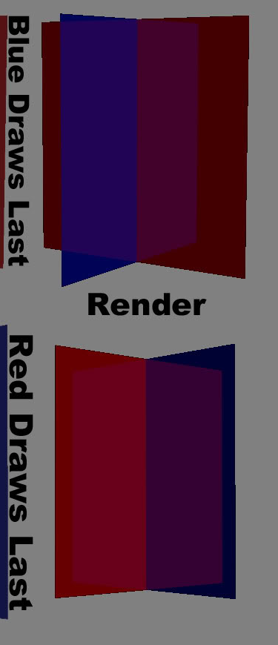
Transparency
Before transparency, we typically only had to make at most one draw call per pixel.
A draw call must be made for every mesh in front of the Z-depth.
Sorting is not free and most realtime approaches have to tolerate a degree of inaccuracy.
http://www.opengl.org/wiki/Transparency_Sorting#Standard_translucent
Poorly managed transparency is one of the biggest framerate killers, and there is only so much that the graphics programmer can do. Responsibility for sensible use of transparency lies with the artist.

Slide 47
Transparency
Optimisations
Where possible, favour alpha testing
Keep your mesh as small as possible, even if it costs more triangles.
Fewer, more opaque cards (40%) are much cheaper than many, very transparent cards (10%) to get a similar effect
Since transparent materials are basically forward-rendered, keep affecting lights low (no lighting is best!)
For special effects consider order-independent blends like “add” to avoid sorting

Slide 48
OPTIMISATION – Texture considerations

Slide 49
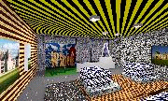
Filtering and Mip Maps
We usually only sample one texel per pixel.
This may not be a good representation
This will typically change in an ugly way (tearing) as the camera or object moves
Notes:
When sampling textures for distant objects, selecting one pixel from the texture sheet (texel) to represent one pixel in screen space may not be representative.
This can result in screen-space pixels of starkly different colours. When the player moves, the sampled texels vary greatly as the samples fall on different parts of the texture.

Slide 50
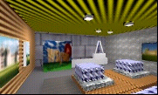
Filtering and Mip Maps
Mip maps are downsized by an image-editing program and saved with the texture
Uses more memory
Matches screen space to mip size to sample a texel representative of the area covered by the pixel
Newer filtering methods result in a less blurry appearance than the screenshot
More stable image under movement
Notes:
To solve this we could sample several pixels on the texture and average them each time we sample, but this would be very intensive.
Instead we store smaller sizes of the texture – this uses MORE memory but to allow more representative samples to be taken. With no cost to performance

Slide 51
Texture padding and bleed
Mip-maps will blend nearby pixels together, which we generally want. However, we don’t want pixels from different islands bleeding into each other.
Equally, blended materials will blend with the background at low mips. Make sure it’s a suitable colour.
Leave space between islands (~4px for a 512x512 texture)
Use a suitable background colour
Better yet, use a Photoshop Action to blur your image and use that as your background

Slide 52
Texture resolution
Until you hit the VRAM limit of the graphics card, large texture sizes do not affect framerate significantly.
When you hit the VRAM limit, performance will plummet SIGNIFICANTLY.
Plan to avoid this ever happening ever, ever, ever.
(planning happens first, remember?)

Slide 53
So I may as well use big textures?
Renderer chooses mip level appropriate to screen coverage
If the object is not viewed closely at any time, then fullres may never be used!
Exceeding the VRAM limit is disastrous
Try to judge the resolution you need based on gameplay, not inside the editor or modelling program

Slide 54
But you didn’t mention triangle counts?!

Slide 55
Triangle/Poly Count
Current-gen (‘12) hardware for PC and home consoles:
Draw calls for fewer than 1,000 tris almost as expensive as 1,000 tris.
Consider combining meshes if your meshes have less than 1,000 tris. The draw call savings are much more significant.
Current engines handle millions of tris per frame.
Triangles that will never occupy more than 1 pixel on-screen are pointless and can hurt performance a bit.
Bottom line:
Triangle count reduction is usually a very time-consuming and low-impact way to optimise for current-gen.

Slide 56
So what can we conclude?

Slide 57
Conclusions
The most important optimisations for frame rate:
Limit the expense of transparency used
Reduce overlapping
Favour stencilled
Reduce the number of draw calls wherever possible:
Reducing number of objects on-screen (place fewer or occlude more)
Combining meshes in vistas
Reduce the expense of lights
Avoid excessive overlapping lights
Fewer shadow-casting
The most important optimisations for memory:
Keep texture size down
Consider decals and vertex painting to break up large surfaces rather than huge textures
Re-use texture space by planning
Use instancing

Slide 58
FIN …ally!

Slide 59
References
Beautiful, Yet Friendly – Guillaume Provost
Game Developer magazine, June and July 2003
http://www.ericchadwick.com/examples/provost/byf2.html
An intro to modern OpenGL. Chapter 1: The Graphics Pipeline - Joe Groff
http://duriansoftware.com/joe/An-intro-to-modern-OpenGL.-Chapter-1:-The-Graphics-Pipeline.html
Graphics Programming slides University of North Carolina - Stephen J. Guy
http://comp575.web.unc.edu/files/...(various)
Wikipedia (of course!)
www.wikipedia.org

Slide 60
Picture Usage
I have used pictures from many, many sources and sadly cannot remember where I got most of them from. All were freely available on the internet (not in paid-for tutorials or the like).
Please accept my apologies for not crediting your pictures, but please know that they have been put to good use for educational purposes and that this presentation is freely available for all and I will receive no financial benefit.
Thanks guys!
Mike

Slide 61
Further Reading
CryEngine 3 Optimisation Guidelines:
General Optimisation:
http://freesdk.crydev.net/display/SDKDOC3/Asset+Performance+Guidelines
Asset Guidelines:
http://freesdk.crydev.net/display/SDKDOC3/Asset+Guidelines
Unreal Engine 3 Optimisation:
GPU:
http://udn.epicgames.com/Three/GPUProfilingHome.html
Monitoring performance in UDK:
http://udn.epicgames.com/Three/StatsDescriptions.html
Memory:
http://udn.epicgames.com/Three/MemoryProfilingHome.html
Wikipedia (of course!)
http://en.wikipedia.org/wiki/Graphics_pipeline

